Slide 1
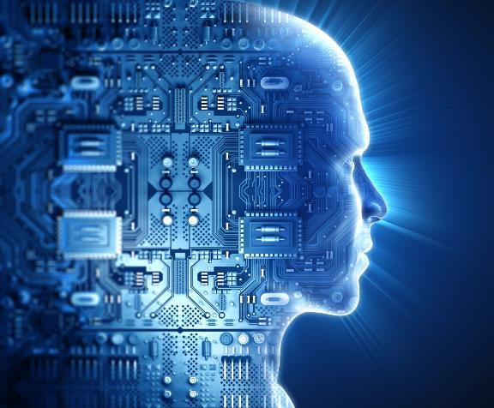
ITEC-200 The Edge of Information Technology
Chapter 6 – Information Security
Image source: https://itpeernetwork.intel.com/xeon-scalable-powers-future-ai/

Slide 2
Acknowledgements
Professor Ruth A. Guthrie at California Polytechnic University, Pomona, has granted a permission for this instructor to use and/or modify the PPT for her CIS310
http://www.cpp.edu/~raguthrie/CIS310/
for this MIS 315 online class.
Dave Hemenway has modified these slides, and has added others to Professor Guthrie’s excellent slides. He accepts total responsibility for their content.

Slide 3
Chapter 6 Learning Objectives
Identify the information security triad
Identify and understand high-level concepts surrounding information security tools
Secure yourself digitally, including from data loss

Slide 4
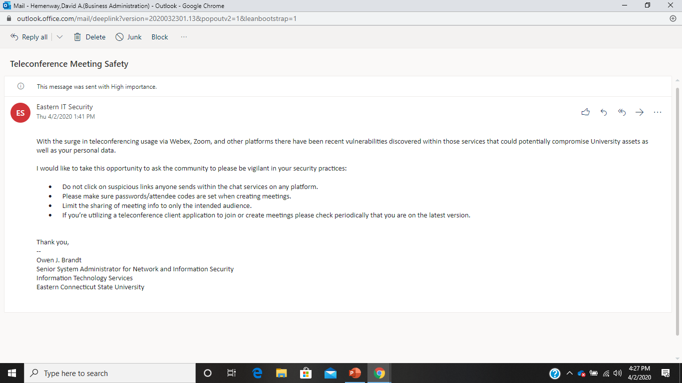

Slide 5
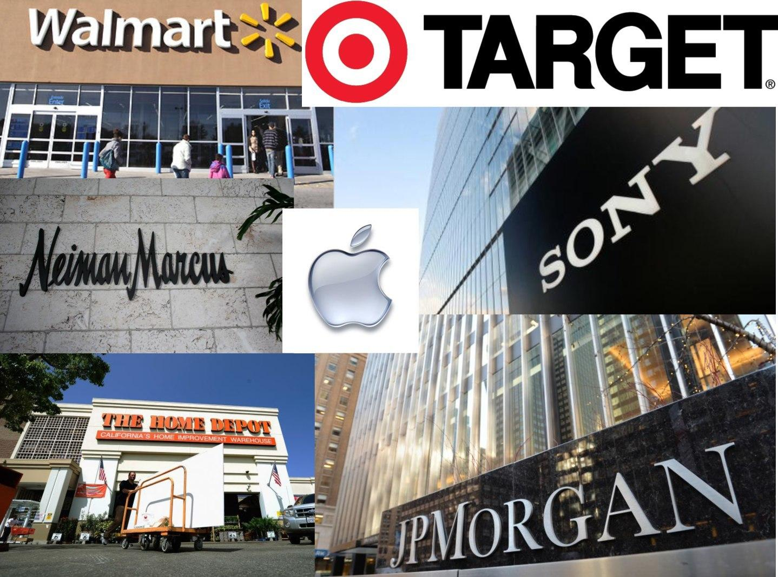
Image source: https://ems-solutionsinc.com/blog/come-brma-today-hear-new-workshop-conducting-cyber-security-exercises-era-breach-day/

Slide 6
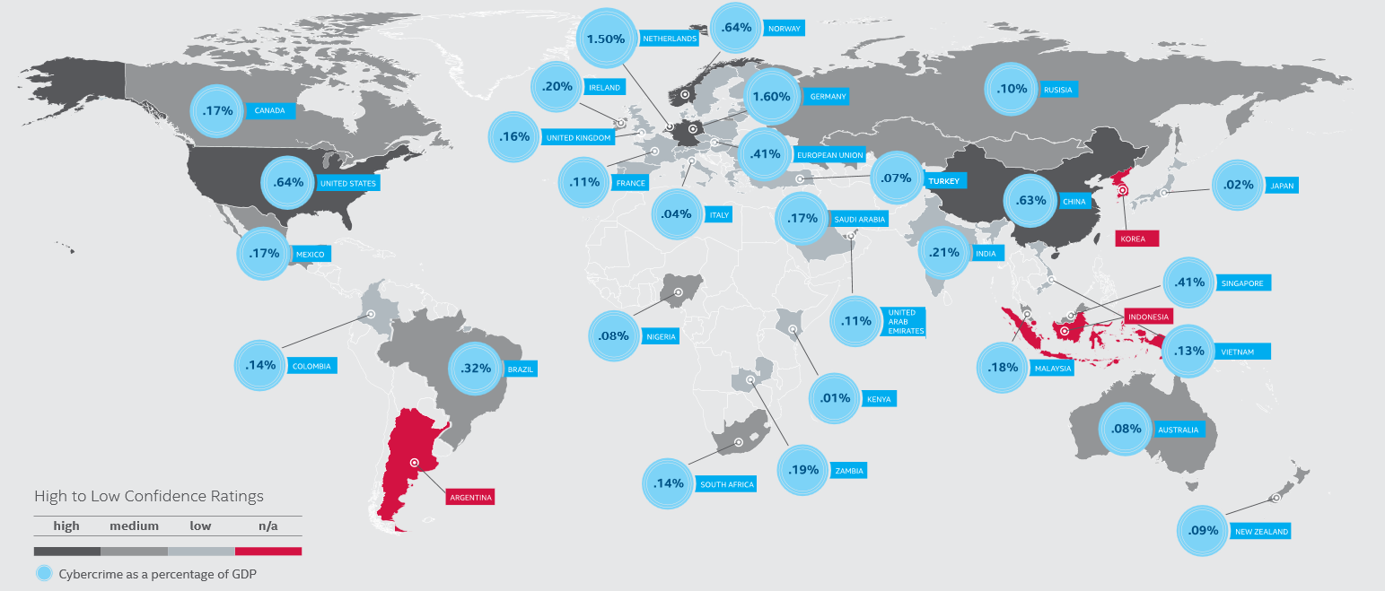
Cybercrime as a Percentage of GDP

Slide 7
Countries With a GDP Greater than 1.0 Trillion Dollars
Estimated Cybercrime In US Dollars for 2017
 |  |  |  | Estimated
Ranking | Country | Gross Domestic Product | Cybercrime | Dollar Value
 |  | (GDP) in Trillion $ | % Loss of GDP | of Cybercrime
1 | United States | 21.44 | 0.64% | $137,216,000
2 | China | 14.14 | 0.63% | $89,082,000
3 | Japan | 5.15 | 0.02% | $1,030,000
4 | Germany | 3.86 | 1.60% | $61,760,000
5 | India | 2.94 | 0.21% | $6,174,000
6 | United Kington | 2.83 | 0.16% | $4,528,000
7 | France | 2.71 | 0.11% | $2,981,000
8 | Italy | 1.99 | 0.04% | $796,000
9 | Brazil | 1.84 | 0.32% | $5,888,000
10 | Canada | 1.73 | 0.17% | $2,941,000
11 | Russia | 1.64 | 0.10% | $1,640,000
12 | South Korea | 1.63 | dna | dna
13 | Spain | 1.40 | dna | dna
14 | Australia | 1.38 | 0.08% | $1,104,000
15 | Mexico | 1.27 | 0.17% | $2,159,000
16 | Indonesia | 1.11 | dna | dna
GDP Source: | https://www.investopedia.com/insights/worlds-top-economies/
 | This list is based on the IMF's World Economic Outlook Database, October 2019.
Cybercrime Source: "Economic Impact of Cybercrime - No Slowing Down,
 | Center for Strategic and International Studies (CSIS), 2018
 | dna = data not available

Slide 8
Net Losses: Estimating the Global Cost of Cybercrime
Activity | Cost As % of GDP
Maritime Piracy | 0.02% (global)
Cybercrime | 0.8% (global)
Counterfeiting/Piracy | 0.9% (global)
Narcotics | 0.9% (global)
Car Crashes | 1.0% (US)
Transnational Crime | 1.2% (global)
Pilferage | 1.5% (US)
Source: McAfee (June 2014)

Slide 9
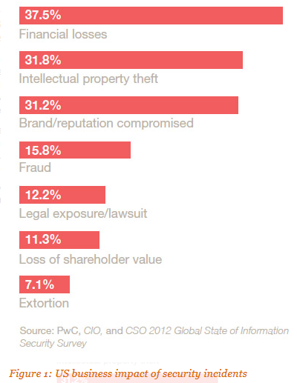
US Business Impact of Information Security Incidents
Source: PWC (2015) http://www.pwc.com/us/en/view/issue-15/cybersecurity-business-priority.jhtml

Slide 10
What is Stolen (Trend Micro)
Personally identifiable information (PII): Names, addresses, Social Security numbers, and other information.
Financial data: Banking, insurance, billing, and other information.
Health data: Hospitals and doctors' office records, medical insurance, and other information.
Education data: School, college, university, or related records.
Payment card data: Credit, debit, store-branded credit, and prepaid gift cards.
Credentials: Log-in credentials to eBay, PayPal, Web-based emails, online banking sites, and others.
Other: Intellectual property, intelligence about an organization, and other information
Source: https://www.trendmicro.de/cloud-content/us/pdfs/security-intelligence/white-papers/wp-analyzing-breaches-by-industry.pdf

Slide 11
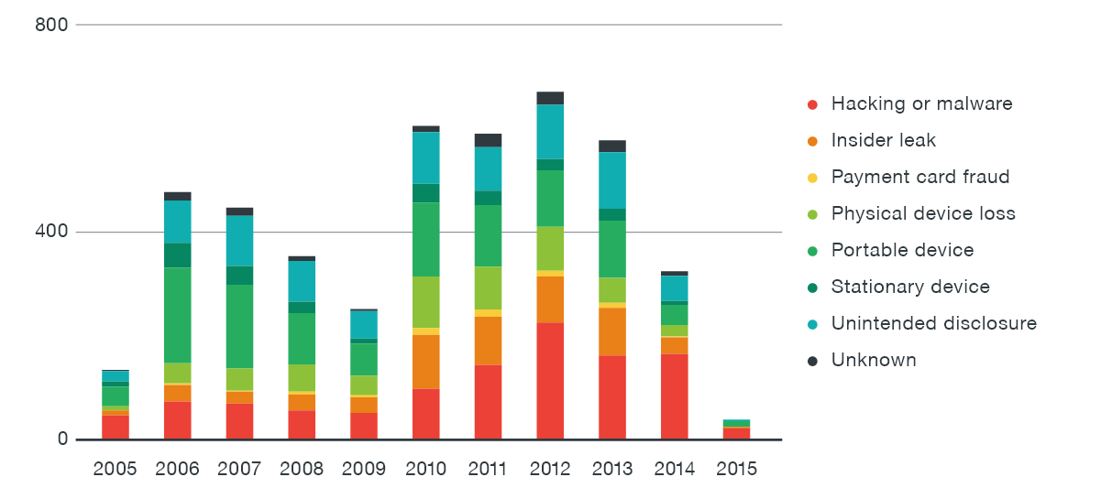
Breach methods observed from 2005 to April 2015 (Trend Micro)
Source: https://www.trendmicro.de/cloud-content/us/pdfs/security-intelligence/white-papers/wp-analyzing-breaches-by-industry.pdf

Slide 12
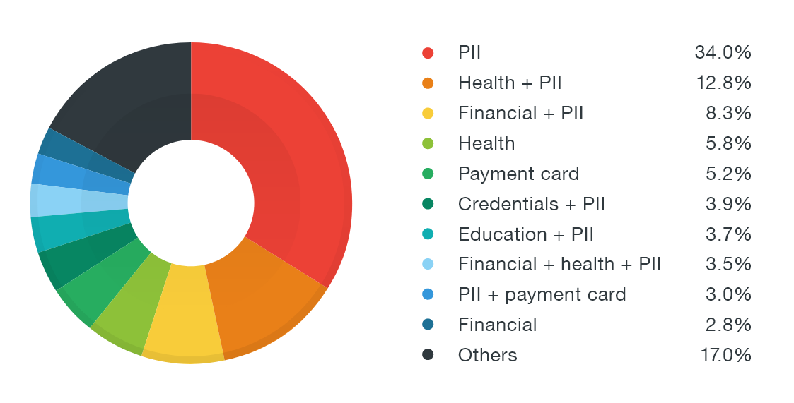
Record-type combinations compromised 2005 to April 2015 (Trend Micro)
Source: https://www.trendmicro.de/cloud-content/us/pdfs/security-intelligence/white-papers/wp-analyzing-breaches-by-industry.pdf

Slide 13
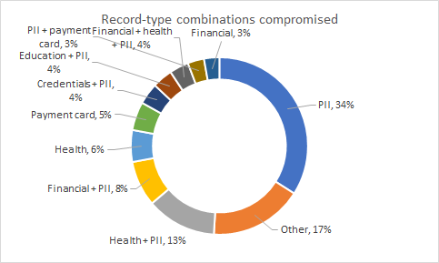
Record-type combinations compromised 2005 to April 2015 (Trend Micro)
Source: https://www.trendmicro.de/cloud-content/us/pdfs/security-intelligence/white-papers/wp-analyzing-breaches-by-industry.pdf

Slide 14
Ransomware
Ransomware is the fastest growing cybercrime. Ransomware victims include big companies, small and medium enterprises, and individual consumers. While the cost to the individual is low, usually about $200 in ransom, the ability to hit thousands of targets at a low cost and with no risk of penalty explains why this category of cybercrime is growing so quickly. While many victims do not pay ransom, enough do to make this profitable. The FBI reported $209 million in ransom was paid in the first quarter of 2016, compared to just $24 million in ransom payments in all of 2015.
Source: McAfee Labs from several sources

Slide 15
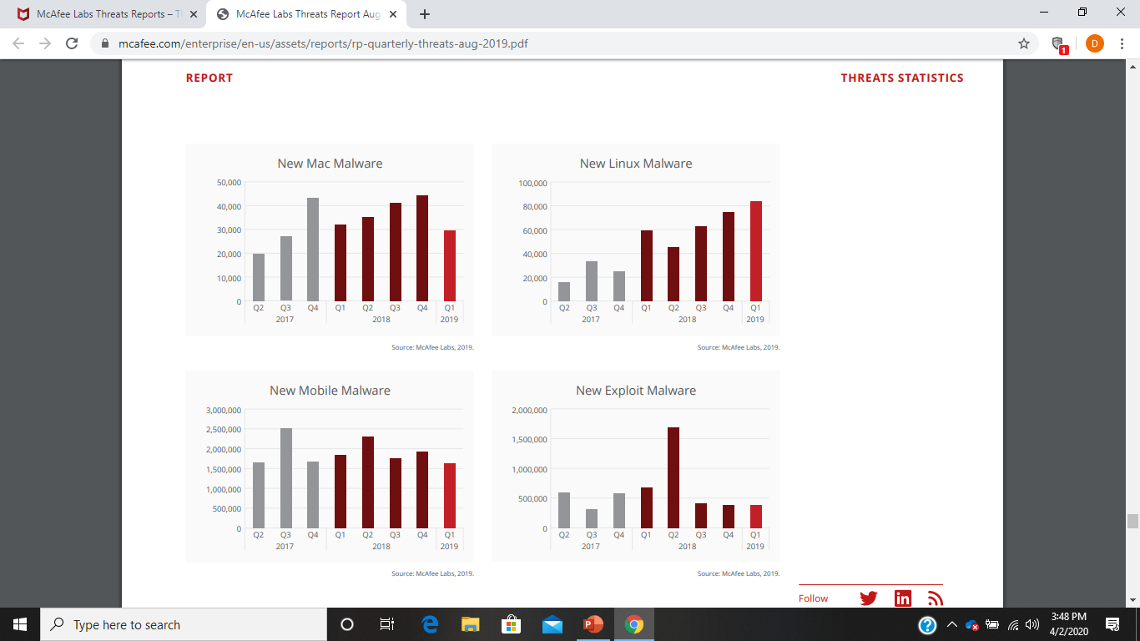

Slide 16
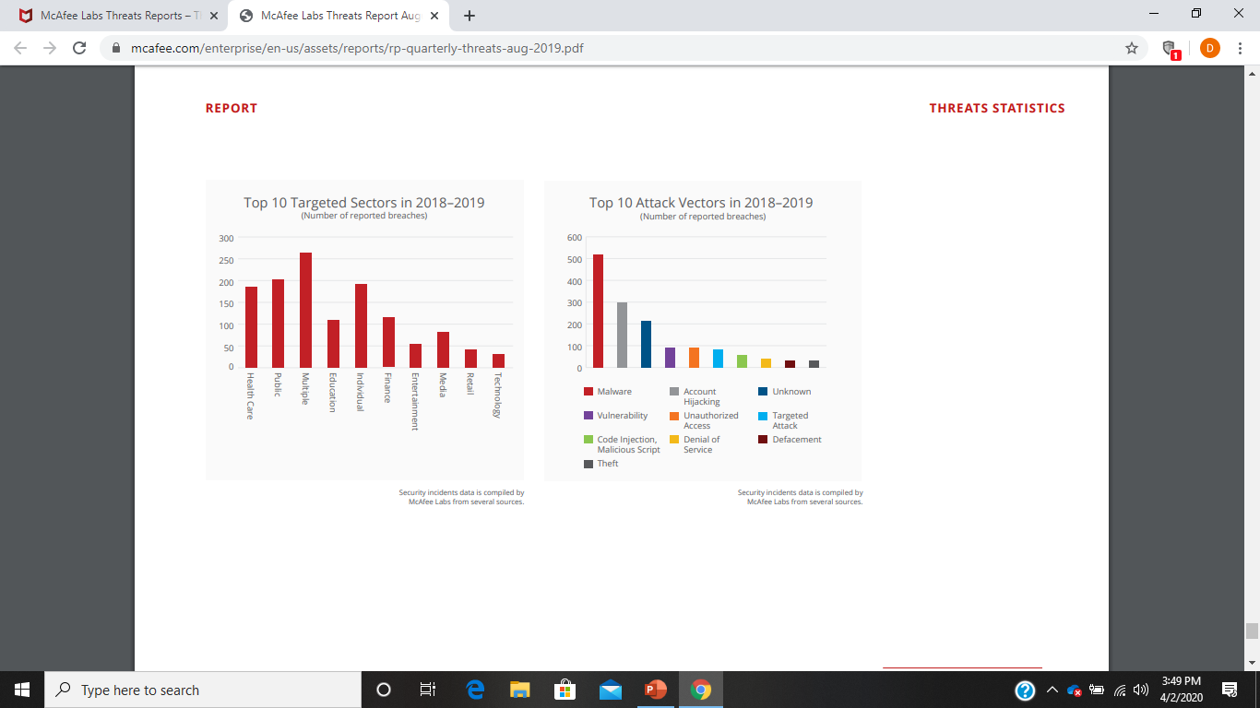

Slide 17
Why is the internet not secure?

Slide 18
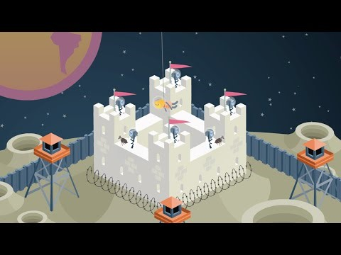
Video source: https://www.youtube.com/watch?v=sdpxddDzXfE

Slide 19
Motivations behind cyberattacks
Extortion
Espionage
Cyberwarfare
Terrorism
Prankster
Protest Hacking (Hacktivism)
Intellectual Property (IP) Theft
Revenge

Slide 20
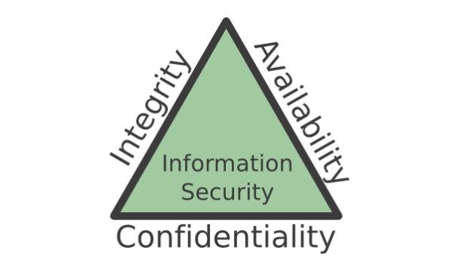
Information Security Triad :
Confidentiality, Integrity, Availability (CIA)

Slide 21
Confidentiality
Protecting information means you want to want to be able to restrict access to those who are allowed to see it. This is sometimes referred to as NTK, Need to Know. Everyone else should be disallowed from learning anything about its contents. This is the essence of confidentiality. For example, federal law requires that universities restrict access to private student information. Access to grade records should be limited to those who have authorized access.
Source: Information Systems for Business and Beyond (2019), David Bourgeois, Joseph Mortati, Shouhong Wang, and James Smith

Slide 22
Integrity
Integrity is the assurance that the information being accessed has not been altered and truly represents what is intended. Just as a person with integrity means what he or she says and can be trusted to consistently represent the truth, information integrity means information truly represents its intended meaning. Information can lose its integrity through malicious intent, such as when someone who is not authorized makes a change to intentionally misrepresent something. An example of this would be when a hacker is hired to go into the university’s system and change a student’s grade. Integrity can also be lost unintentionally, such as when a computer power surge corrupts a file or someone authorized to make a change accidentally deletes a file or enters incorrect information.
Source: Information Systems for Business and Beyond (2019), David Bourgeois, Joseph Mortati, Shouhong Wang, and James Smith

Slide 23
Availability
Information availability is the third part of the CIA triad. Availability means information can be accessed and modified by anyone authorized to do so in an appropriate timeframe. Depending on the type of information, appropriate timeframe can mean different things. For example, a stock trader needs information to be available immediately, while a sales person may be happy to get sales numbers for the day in a report the next morning. Online retailers require their servers to be available twenty-four hours a day, seven days a week. Other companies may not suffer if their web servers are down for a few minutes once in a while.
Source: Information Systems for Business and Beyond (2019), David Bourgeois, Joseph Mortati, Shouhong Wang, and James Smith

Slide 24
Information Security Triad :
Confidentiality, Integrity, Availability (CIA)

Slide 25
Information Security
People
Are the first line of defense
Must be informed or trained
Certain skillsets are required - it's not just the CIO's job

Slide 26
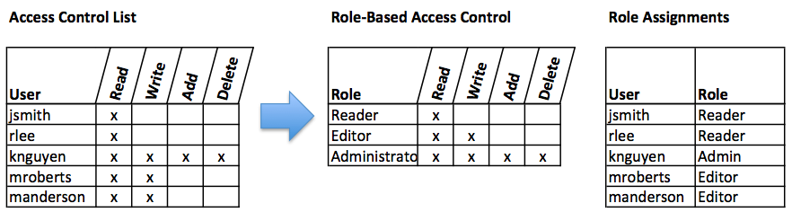
Tools for Information Security - Access Control
Who can do what
Which roles can do what

Slide 27
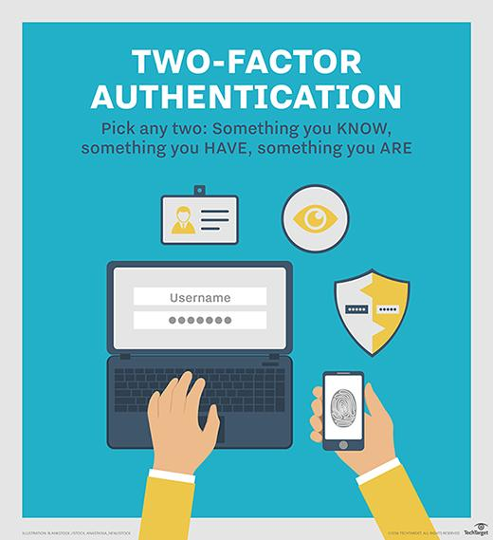
Tools for Information Security
Image source: http://searchsecurity.techtarget.com/definition/two-factor-authentication

Slide 28
Information Security: Authentication
Authentication can be accomplished by identifying someone through one or more of three factors:
1. Something they know 2. Something they have
3. Something they are.

Slide 29
Information Security
Processes
Corporate policies (governance) and culture (Bring Your Own Device - BYOD)
Liability Insurance standards (which don't yet exist)
Government regulations (e.g., EU Safe Harbor)
Backup for individual machines and servers

Slide 30
Password Security
Require complex passwords. One reason passwords are compromised is that they can be easily guessed.
Change passwords regularly. It is essential that users change their passwords on a regular basis.
Train employees not to give away passwords. One of the primary methods used to steal passwords is to simply figure them out by asking the users for their password.

Slide 31
Encryption
Encryption is a process of encoding data upon its transmission or storage so that only authorized individuals can read it. This encoding is accomplished by software which encodes the plain text that needs to be transmitted (encryption). Then the recipient receives the cipher text and decodes it (decryption). In order for this to work, the sender and receiver need to agree on the method of encoding so that both parties have the same message.
Source: Information Systems for Business and Beyond (2019), David Bourgeois, Joseph Mortati, Shouhong Wang, and James Smith

Slide 32
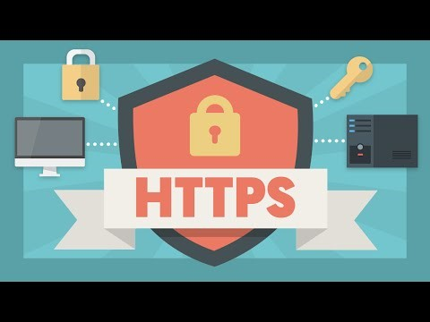
Tools for Information Security - Encryption
Video source: https://www.youtube.com/watch?v=w0QbnxKRD0w

Slide 33
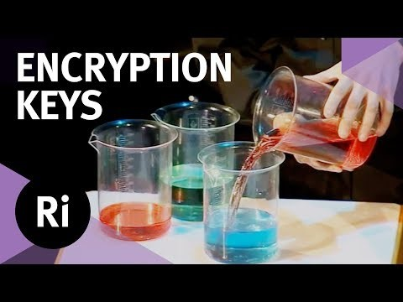
Tools for Information Security - Encryption
Video source: https://www.youtube.com/watch?v=EDTx3meIeT0

Slide 34
Information Security
Systems
Firewalls
Virus, malware, and spyware detection
OS/application patches
Network intrusion detection
Backup/failover for critical processes

Slide 35
What can you do to protect yourself?
Keep your software updated.
Stop using "free" email and Google.
Use encryption on your devices.
Surf securely.
Be careful with cloud services in the US.
Stop using social media.
Only use location services when needed.
Use passphrases instead of passwords.
Only use public Wi-Fi on encrypted sites (https://)
Do regular, multiple backups.
Turn off your phone, tablet, or computer.

Slide 36
Protect Against Data Loss
"Backup Rule of Three"
3 copies of anything you care about - Two aren't enough if it's important.
2 different formats - Example: Dropbox and Hard Drive or USB
1 off-site backup - If the house burns down, how will you get your data back?

Slide 37
Protect Against Data Loss
Here is what I do:
Daily Backups (4)
Encrypted USB drive
Second laptop
Cloud (AU and home)
Monthly Backups (2)
External Hard Drive
DVD
in a fireproof safe

Slide 38
Chapter 6 Summary
As computing and networking resources have become more an integral part of business, they have also become a target of criminals. Organizations must be vigilant with the way they protect their resources. The same holds true for individuals. As digital devices become more intertwined in everyone’s life, it becomes crucial for each person to understand how to protect themselves.

Slide 39
Certified Information Systems Security Professional
Certified Information Systems Security Professional (CISSP) is an information security certification developed by the International Information Systems Security Certification Consortium, also known as (ISC)². The CISSP designation is a globally recognized, vendor-neutral standard attesting to an IT security professional's technical skills and hands-on experience implementing and managing a security program.
Source: https://searchsecurity.techtarget.com/definition/Certified-Information-Systems-Security-Professional

Slide 40
Serenity Prayer
God grant me the serenity to accept the things I cannot change, the courage to change the things I can, and the wisdom to know the difference.
Source: There is no definitive source for the Serenity Prayer which originated in the first half of the 20th Century.

Slide 41
Things YOU can do:
Back Up your important files. Save them on your computer, on a network or cloud, AND on a backup drive
Empty your downloads folder when done with them
Keep your software current
Do your work when you aren’t tired
Check for mistakes while doing your work
Go for walks when frustrated
Get an Uninterruptible Power Supply (UPS)

Slide 42
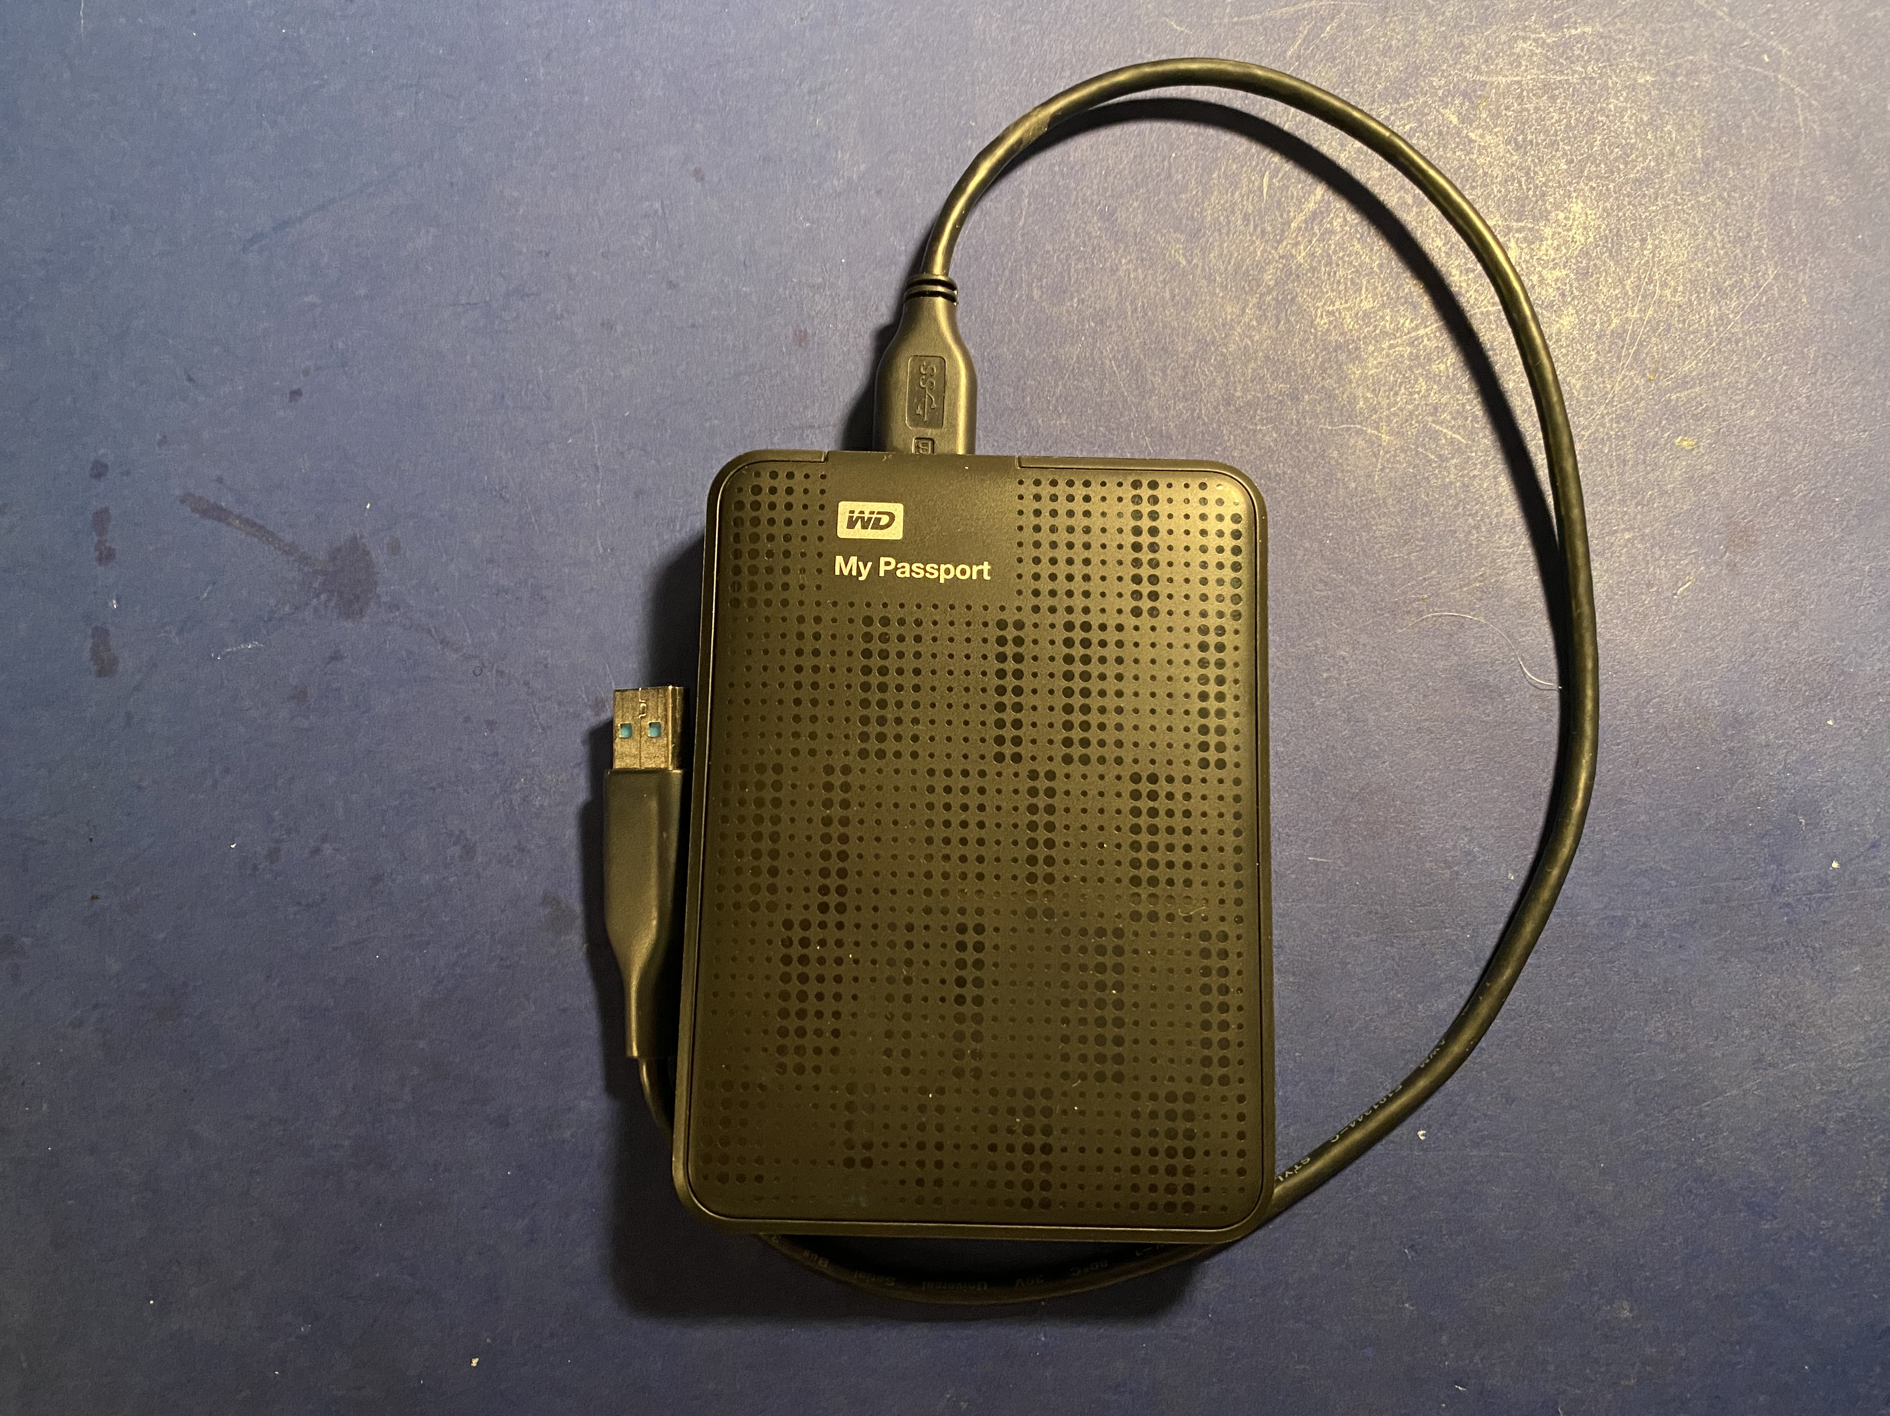
A Simple Backup Drive Using a USB Cord

